Slide 1
TreeS & Binary Tree
Session 15
Elizabeth Paskahlia Gunawan, S.Kom., M.Cs

Slide 2
Learning outcomes
At the end of this session, students will be able to:
LO 1: Explain the concept of data structures and its usage in Computer Science
LO 2: Illustrate any learned data structure and its usage in application
LO 3: Apply data structures using C

Slide 3
Subtopics
Tree
Binary Tree
Type of Binary Tree
Property of Binary Tree
Expression Tree
Tree Traversal

Slide 4
Tree Concept
Tree Introduction
A tree is a non-linear data structure that represents the hierarchical relationships among the data objects
Some of the tree relations can be observed in directory structures or organizational hierarchies.
The node in the tree no need to be stored contiguously and can be stored anywhere and linked by pointers

Slide 5
Tree Concept
Tree Introduction
Root node: The topmost node in the tree.
Edge: Line connecting 2 nodes.
Leaf node: A node that has no children.
Sibling: Nodes that have the same parent.
Path: A sequence of consecutive edges is called a path
Ancestor node: An ancestor of a node is any predecessor node on the path from root to that node.
Descendant node: A descendant node is any successor node on any path from the node to a leaf node.

Slide 6
Tree Concept
Tree Introduction
Level: Every node in the tree is assigned a level number in such a way that the root node is at level 0, children of the root node are at level number 1.
Degree of node is the total number of children that a node has.

Slide 7
Tree Concept
Tree Introduction
Tree is a collection of one or more nodes.
ROOT = A
LEAF = E, F, G, D
PARENT of C = A
CHILDREN of A = B, C, D
SIBLING of F = G
PATH FROM A TO F = A, C, F
ANCESTOR of F = A, C
DESCENDANT of C = F, G
LEVEL OF D = 1
DEGREE of A = 3

Slide 8
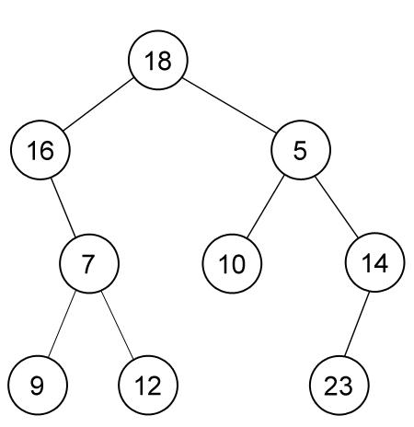
Binary Tree Concept
Binary Tree Introduction and terms
Binary tree is a rooted tree data structure in which each node has at most two children.
Those two children usually distinguished as left child and right child.
A sample of binary tree of 9 nodes, rooted on node which contains 18. Leaves are nodes which contain 9, 12, 10 and 23.

Slide 9
Binary Tree Concept
Binary Tree Introduction and terms
Depth of node: The length of the path from the root to the node.
The depth of root is 0.
Height of a tree: The total number of nodes on the path from the root node to the deepest node in the tree.
A tree with only root node has a height of 1.
With the sample binary tree: Depth of node 12 is 3, and the Height of tree is 4.

Slide 10
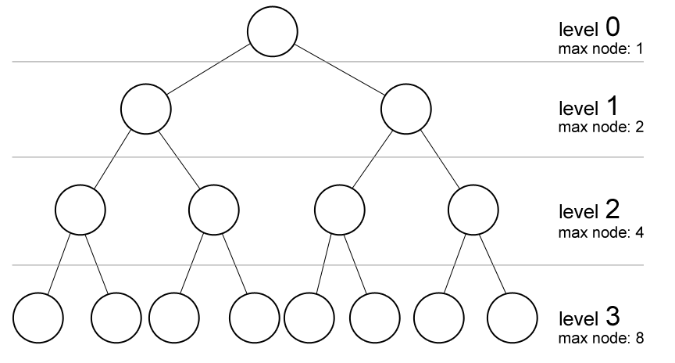
Property of Binary Tree
Maximum number of nodes on certain level
Maximum number of nodes on level k of a binary tree is 2^{k}.
Note: In some literatures,
level of binary tree
starts with 1 (root).

Slide 11
Property of Binary Tree
Maximum number of nodes with Height h
Maximum number of nodes on a binary tree of height h is 2^{h+1} - 1.
Height of a tree is the total number of levels (excluding the root) or the highest level l (if the levels of a tree are: 0, 1, 2, …, l)
The following figure has the height of: 3
Maximum total nodes of a binary tree of height 3
= 1 + 2 + 4 + 8
= 2⁰ + 2¹ + 2² + 2³
= 2⁴ – 1
= 15

Slide 12
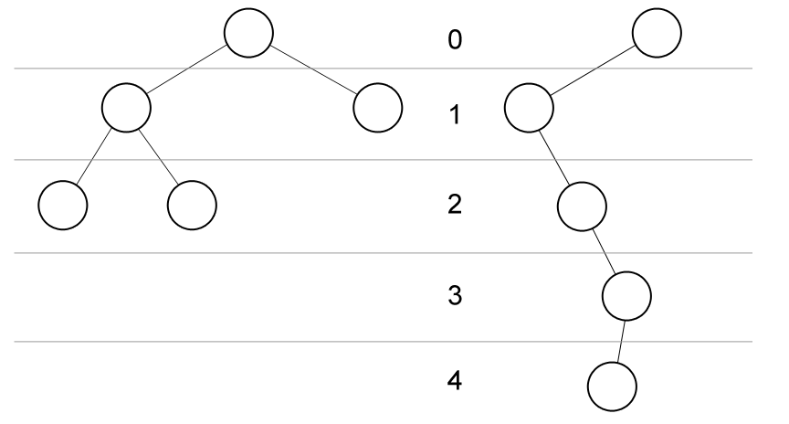
Property of Binary Tree
Minimum and maximum height of Binary tree with known number of nodes
Minimum height of a binary tree of n nodes is ²log(n).
Maximum height of a binary tree of n nodes is n - 1.
Skewed binary trees
have maximum height

Slide 13
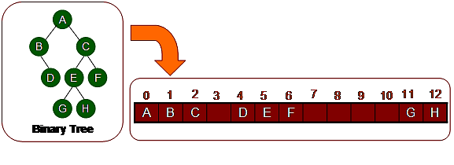
Property of Binary Tree
Representation of Binary Tree
Implementation using array
Index on array represents node number
Index 0 is Root node
Index Left Child is 2p + 1, where p is parent index
Index Right Child is 2p + 2
Index Parent is (p-1)/2

Slide 14
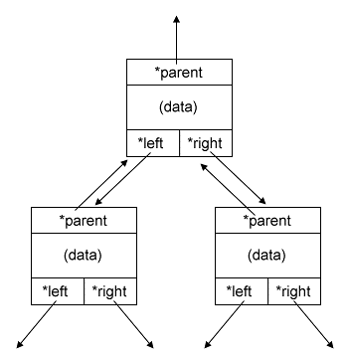
Property of Binary Tree
Representation of Binary Tree
Implementation using linked list
struct node {
int data;
struct node *left;
struct node *right;
struct node *parent;
};
struct node *root = NULL;

Slide 15
Type of Binary Tree
4 Types of binary tree
Perfect Binary Tree: a binary tree in which every level are at the same depth.
Complete Binary Tree: a binary tree in which every level, except possibly the last, is completely filled, and all nodes are as far left as possible. A perfect binary tree is a complete binary tree.
Skewed Binary Tree: a binary tree in which each node has at most one child.
Balanced Binary Tree: a binary tree in which no leaf is much farther away from the root than any other leaf (different balancing scheme allows different definitions of “much farther”).

Slide 16
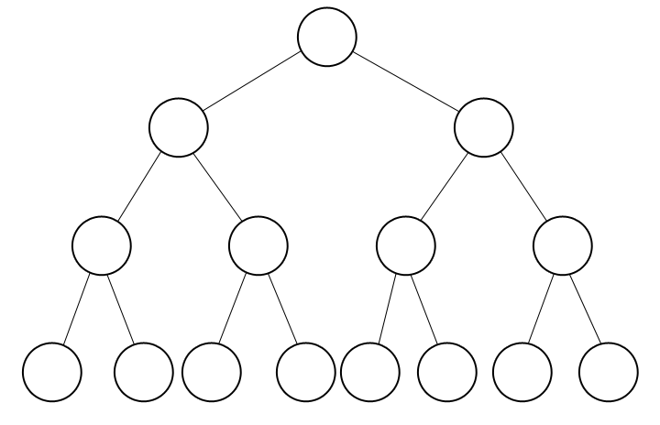
Type of Binary Tree (1 of 4)
PERFECT binary tree

Slide 17
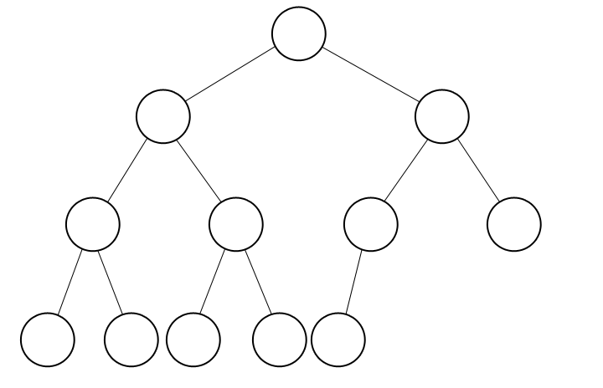
Type of Binary Tree (2 of 4)
COMPLETE binary tree

Slide 18
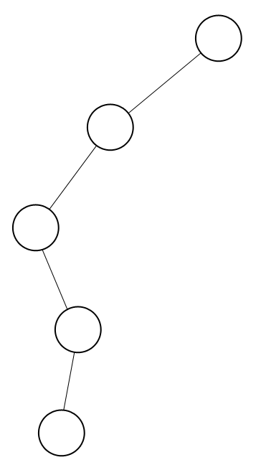
Type of Binary Tree (3 of 4)
SKEWED binary tree

Slide 19
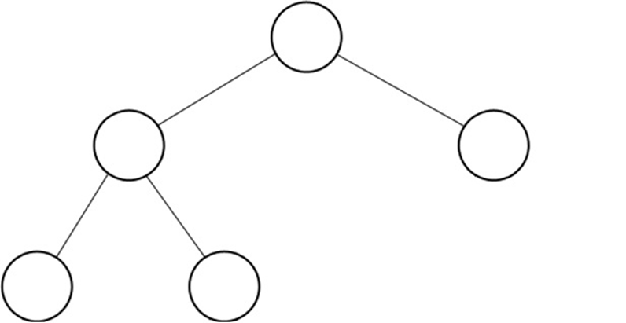
Type of Binary Tree (4 of 4)
BALANCED binary tree

Slide 20
Expression Tree Concept
Recall our discussion on stack application about arithmetic notation
Here we will discuss such arithmetic notation using expression tree.

Slide 21
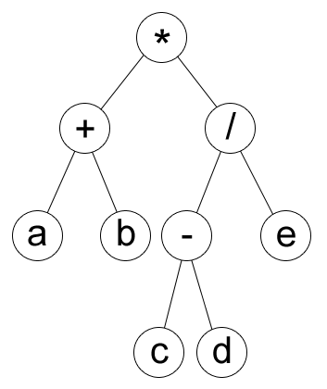
Expression Tree Concept
Prefix : *+ab/-cde
Postfix : ab+cd-e/*
Infix : (a+b)*((c-d)/e)

Slide 22
Expression Tree Concept
We will use this structure for each node in the tree:
It is a binary tree.
struct node {
int data;
struct node *left;
struct node *right;
};

Slide 23
Expression Tree Concept
Create Expression Tree from Prefix
We can create an expression tree from a prefix by recursive.
main function
struct tnode *root = newnode(s[0]);
f(root);
char s[MAXN];
int p = 0;
void f(struct tnode *curr) {
if ( is_operator(s[p]) ) {
p++; curr->left = newnode(s[p]);
f(curr->left);
p++; curr->right = newnode(s[p]);
f(curr->right);
} }

Slide 24
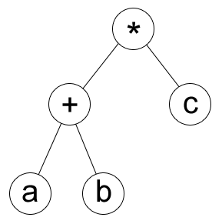
Expression Tree Concept
Prefix Traversal
Doing a prefix or postfix traversal in an expression tree is simple.
In prefix, you have to print/process before its child are processed.
void prefix(struct tnode *curr) {
printf( “%c “, curr->chr );
if ( curr->left != 0 ) prefix(curr->left);
if ( curr->right != 0 ) prefix(curr->right); }

Slide 25
Expression Tree Concept
POSTfix Traversal
Doing a prefix or postfix traversal in an expression tree is simple.
In postfix, you have to print/process after its child have been processed.
void postfix(struct tnode *curr) {
if ( curr->left != 0 ) postfix(curr->left);
if ( curr->right != 0 ) postfix(curr->right); printf( “%c“, curr->chr );
}

Slide 26
Expression Tree Concept
INfix Traversal
How about infix? Can we just do like this code below?
It’s seems right, but infix may have operator precedence ambiguity without brackets.
void infix(struct tnode *curr) {
if ( curr->left != 0 ) infix(curr->left);
printf( “%c“, curr->chr );
if ( curr->right != 0 ) infix(curr->right); }

Slide 27
Expression Tree Concept
INfix Traversal
For example * + a b c in prefix will be encoded in infix as a + b * c with the previous code, while the correct infix is (a + b) * c.
a + b * c : b is multiplied by c and then added by a
(a + b) * c : a is added by b and then multiplied by c

Slide 28
Expression Tree Concept
INfix Traversal
Prefix : *+abc
Postfix : ab+c*
Wrong infix : a+b*c
Correct infix : (a+b)*c

Slide 29
Expression Tree Concept
INfix Traversal
To fix that, we can add brackets () when expanding an operator.
So * + a b c in prefix will be encoded as ((a + b) * c) in infix, which is correct.
void infix(tnode *curr) {
if ( is_operator(curr->chr) ) putchar( '(' );
if ( curr->left != 0 ) infix(curr->left);
printf( "%c", curr->chr );
if ( curr->right != 0 ) infix(curr->right);
if ( is_operator(curr->chr) ) putchar( ')' );
}

Slide 30
Expression Tree Concept
Create Exp-Tree from Postfix
Now, can you create an expression tree given a postfix notation?
Hint: scan from right to left.

Slide 31
Tree Traversal
Tree traversal techniques
In general, there are two ways to traverse a tree:
Depth-first search
Breadth-first search (Level-order)

Slide 32
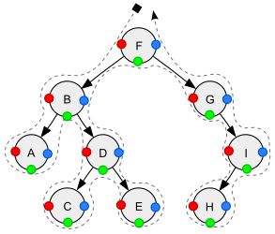
Tree Traversal
Depth First Search
The search tree is deepened as much as possible before going to the next sibling.
There are three methods at which position of the traversal relative to the node: Pre-Order, In-Order, and Post-Order.
- Pre-order (node visited at position red ●): F, B, A, D, C, E, G, I, H;
- In-order (node visited at position green ●): A, B, C, D, E, F, G, H, I;
- Post-order (node visited at position blue ●): A, C, E, D, B, H, I, G, F.

Slide 33
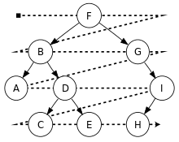
Tree Traversal
Breadth First Search
The search tree is broadened as much as possible before going to the next depth.
- BFS (Level-order): F, B, G, A, D, I, C, E, H.

Slide 34
References
S. Sridhar. 2015. Design and Analysis of Algorithms. Oxford University Press. New Delhi. ISBN: 9780198093695. Chapter 5
Reema Thareja. 2014. Data structures using C. Oxford University Press. New Delhi. ISBN:9780198099307. Chapter 9
Binary Trees, http://cslibrary.stanford.edu/110/BinaryTrees.html

